Slide 1

Visualizing the No-Cloning Theorem
Team Name: Observers
Team Members:
Akshayasri Baskar II CSE
Shihana T II BSc Physics Hons
Hridya J S II BSc Physics Hons
Ardhra V S II BSc Physics Hons

Slide 2
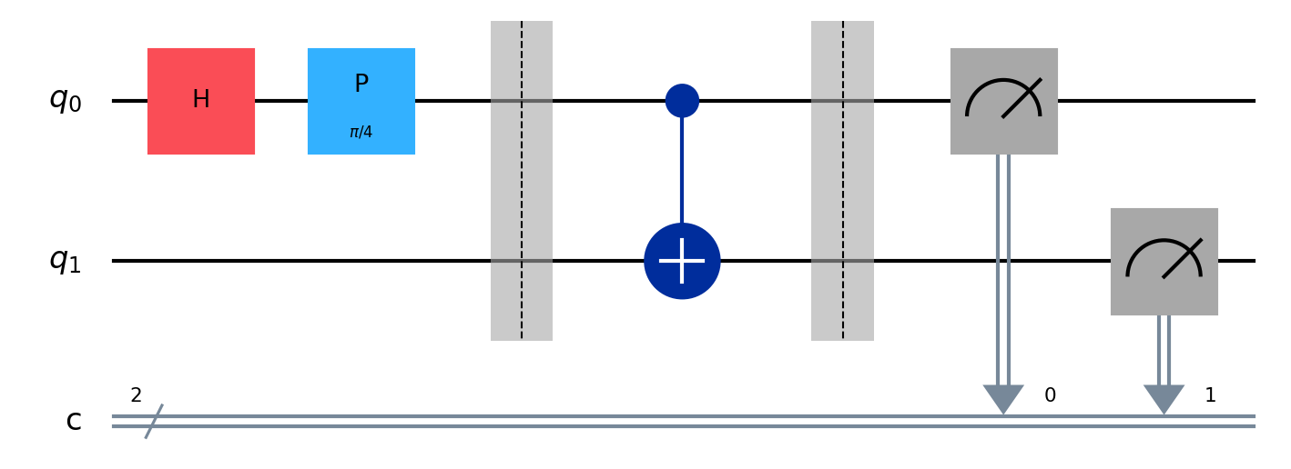
Problem Identification
The Challenge: In classical networks, data can be copied and intercepted without leaving any physical trace or alert.
The Quantum Edge: We utilize the No-Cloning Theorem, which dictates that an "unknown" quantum state cannot be copied without being physically altered
Goal: To build a self-auditing communication channel that automatically detects eavesdropping

Slide 3

Objectives
Key Objectives and Limitations
Objective: Prove cloning is impossible
Mechanism: Eve's CNOT interaction
Success Metric: Detection occurs when the error rate exceeds the industry-standard 11% security threshold.
Constraints: The message must be prepared in a non-orthogonal state (using H + P gates) so it remains "unknown" to the attacker.
Entanglement creates detectable noise

Slide 4
Implementation Strategy
Framework: Built with Qiskit using the BasicProvider for consistent, cross-platform simulation.
The Protocol:
Alice: Encodes a message using a Phase (P) gate at pi/4.
Eve: Attempts to clone the message using a CNOT gate, which unintentionally creates Entanglement instead of a copy.
Security Barriers: Used qc.barrier() to prevent simulator optimization, ensuring Eve's attack represents a realistic physical interception.
GitHub Link: https://github.com/Akshara-1/Visualizing_No_Cloning

Slide 5
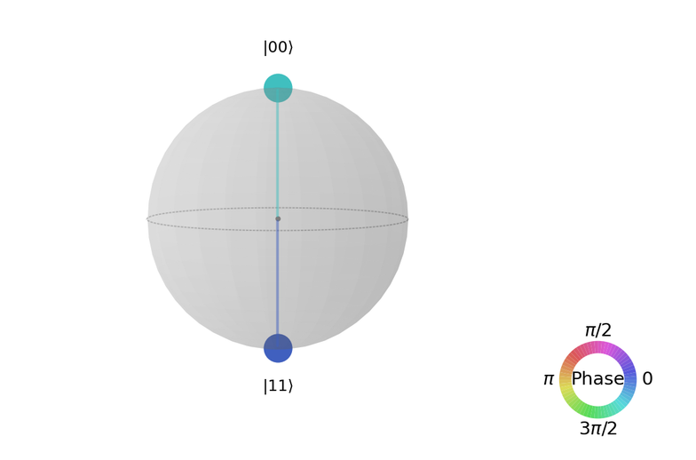
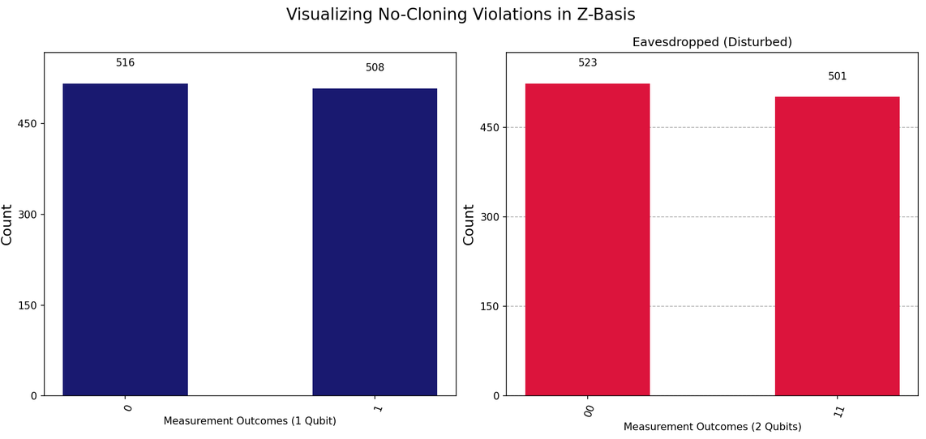
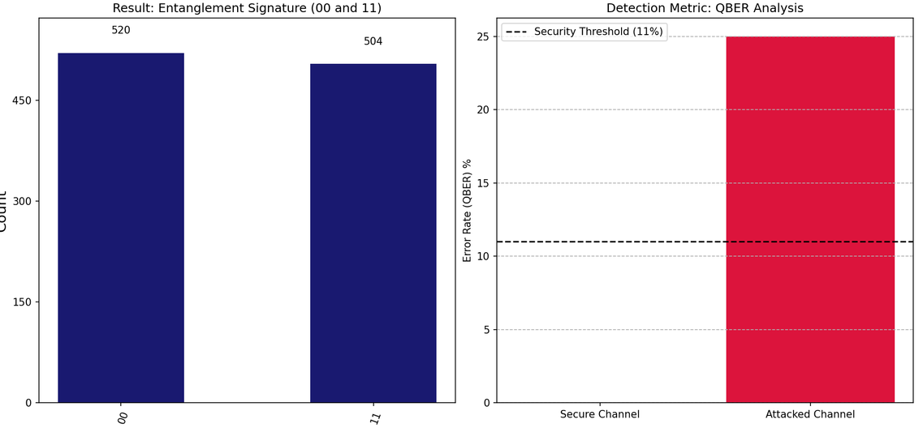
OUTPUTS
Graph 2: QSphere (Global Mapping)
Graph 1: Comparative Histogram (Statistical Proof)
Graph 3: QBER Analysis

Slide 6
Results and Analysis
Our "Attacked Channel" generated a error rate more than double the 11% Security Threshold.
Conclusion: The eavesdropping attempt is mathematically and physically impossible to hide.
The Entanglement Trap: Eve’s attempt to copy the state via CNOT forced Alice’s qubit into a Bell-state entanglement.
Practical Feasibility: Proves that quantum-secured channels (like those needed for Banking or Aadhaar operations) are self-auditing.
Current Limitation: While 100% accurate in a simulator, real hardware noise would require Error Mitigation to distinguish "Eve" from "Decoherence"

